Slide 1

https://www.uni-goettingen.de/en/48115.html
UNPLAB-h²_GxE_Ch-6[QTL-Detection]
1

Slide 2
Sequential Number: #18
UNPLAB-h²_GxE_Ch-6[QTL-Detection]
Unless I explicitly state otherwise, images and cartoons are created using ChatGPT.
You may use this material free of charge under the terms of the CC BY license. This requires that you provide appropriate attribution to the author: W. Link, University of Goettingen, Germany.
In a few cases, individual images, photographs, or similar material may be subject to a more restrictive Creative Commons license. Where this applies, it is explicitly indicated, and you must comply with the stated license terms for those items.
Please check the license information carefully before reuse. Responsibility for complying with the applicable license terms rests entirely with you.
2

Slide 3
You already know: You already know:
Population Genetics.
Heritability. GxE
Breeder’s Equation. Predicted and Realized Gain from Selection
Keywords of this chapter: How to detect so-called QTL, how to assess the impact (effect) on trait expression of the allelic variants segregating at QTL.
Algebra as introduced in this chapter: none.
3

Slide 4
How to mark so-called QTL, employing DNA-markers. And how to estimate the effect of such QTL on our trait. Basic considerations.
© Drawing: Courtesy F. Kopisch-Obuch
QTL. Quantitative Trait Locus. The chromosomal locus (position on chromosome) ‘with’ two or more alleles in the focal population; and that segregating locus has influence on the variation of a quantitative traits. A QTL is, honestly, often not simply the ‘place’ where (the allelic versions of) a specific gene is (are) located in the genome, but a QTL is rather a region that includes that locus and may include further loci with or without impact the same trait. A QTL is more like a region - whereas the locus is really the site of the introns and exons and so on of the actual gene. Mapping* such QTL was and is – nevertheless – a first step to learn about the position of genes in genomes.
(*linkage mapping, based on cM, see below).
Czech J. Genet. Plant Breed., 44, 2008 (2): 78–79
One particular talk, considered as excellent by many participants, had a simple but mysterious title,
Where Have All the QTL Gone?. It was given by Dani Zamir (geneticist from Jerusalem, working
on tomato QTL mapping).
Partly Dani Zamir complained that a high amount of phenotypic data are and have been (and since, more have been) collected and used for QTL mapping but are not generally available, not well archived.
But the question can as well be understood as “Have all the QTL been ‘real’ ... and are they meanwhile in use in breeding or are the converted into members of the global data graveyard”? Not all ‘detected’ QTL are real, and even so, some of them may be useless. Useless for instance because they show that a mutated allele causes a defect, yet, in the breeding material such mutated allele is ‘anyway’ absent.
4

Slide 5

How to mark so-called QTL, employing DNA-markers. And how to estimate the effect of such QTL on our trait. Basic considerations.
© Drawing: Courtesy F. Kopisch-Obuch.
A KWS Breeder, therefore it is this colour that indicates the resistance
R
R
R
R
A
R
A
A
A
A
A
R
S
Symbolizes a genotype. The genome of it. Well, with only 1 chromosome per genome, and take it for two homologous chromosomes with the same allele, hence we symbolize homozygous genotypes. The two colours show the areas (pieces, chunks) of the chrom-osome that were inherited from two ancestors (the blue ancestor, the orange ancestor).
Polymorphic, diverse Population. Not necessarily but in cases offspring from a bi-parental cross.
5

Slide 6
How to mark and locate a so-called QTL, employing DNA-markers. And how to esti-mate the effect of such QTL.
Phenotypic result. R=resistant, S=susceptible
R R R R R S R S S S S S
The members of this panel of homozygous geno-types share different parts of their genome with either of their ancestors; and they are either resistant R or susceptible S.
Let us arrange them according to one DNA-marker: (one out of very many and typically genome-wide distributed) ... Call this one DNA-Marker „SNP 1“, being located somewhere in the middle of every-thing.
You know, of course, that we do not deal with these N=12 genotypes. We just do not have neither space nor patience enough to draw more. In true research and breeding, it would be such as N=200 or more.
SNP: Single Nucleotide Polymorphism
DOI: 10.1155/2012/728398
Polymorphic, diverse Population
6

Slide 7
Mark a QTL, employing DNA-markers. Estimate the effect-on-trait of such QTL.
You do not yet see much pattern.
Let us arrange them according to Marker „SNP 1“, being located somewhere in the middle of this chromosome.
At that marker position, some inherited that segment of chromosome from the orange ancestor, some from the blue ancestor.
After arranging them, we see that ‘all’ those inheriting that chromosomal region from the orange ancestor are resistant. Well, this obviously means:
Somewhere there, we have a resistance locus, and the ‚orange‘ allele of it contributes markedly to (or even makes) resistant.
That‘s it. That is it.
That is the basic reasoning in ‘marking’ a QTL.
If you not only want to ‘mark’ it but you want to locate (‘map’) it, then - of course – then you need to know ‘where’ the marker is.
Phenotypic result. R=resistant, S=susceptible
R R R R R S R S S S S S
R S
SNP1
Polymorphic, diverse Population
7

Slide 8
Mark a QTL. Employing DNA-markers. Estimate the effect of such QTL.
Phenotypic result. R=resistant, S=susceptible
R R R R R R S S S S S S
See that all those inheriting that chromosomal region from the orange ancestor are resistant. Somewhere there, we have a locus the ‚orange‘ allele of which contributes markedly to (or even makes) resistance.
That is it.
Unfortunately, that chromosomal area is still big. The causative locus with its highly important alleles resides seemingly somewhere in the greyish-framed area.
The resolution is low. Could we have a better resolution?
Of course, with more recombination, we get higher resolution. Let us imagine that this population went in its past through many more generations of crossing and recombination.
Population of diverse homozygotes
8

Slide 9
Exploit higher resolution due to many more meiosis events in the past of this population
More generations of recombination lead to higher resolution (of course one needs more marker loci to mark these shorter, more numerous chunks of the genome). As a consequence, we have a much more ‚precise‘ location of the causal locus. If your SNP1-marked position is still well differentiating between resistant and susceptible genotypes, then that marker must be quite close to the causal locus. See indicated which recombination events set the limits to the QTL location. Well. Close may still mean that in the framed area we have more than one important genes, maybe even several. It is probably still premature to tell the causative locus and gene.
We can now even estimate the effect of the orange vs. blue QTL-’Allele’, we just have to employ trait values. There we see the effect is Δ=1-0=1 (units of resistance). According to classical Quantitative Genetics UNPLAB-QuGen_Ch-4[MetrMod], the metric additive effect here would, hence, be a=0.5 (half of Δ).
Phenotypic result. R=resistant=1, S=susceptible=0
Mean value =1 Mean value =0
SNP1
Population of diverse homozygotes
9

Slide 10
Even if this was successful, we have to check whether in a different breeding material marker and QLT are still polymorphic, still with high LD, still associated in same phase...
10
Up to here, it went without saying, but it must be said.
The successful setting here implies:
The DNA-marker is polymorphic.
The QTL is polymorphic.
There is strong LD between the QTL and its alleles and the marker and its alleles: One Marker allele is strongly statistically associated with one QTL allele.
This a rare event. Nearly all markers do not fulfil these conditions, of course not!
There is strong LD between the QTL and its alleles and the marker and its alleles: One Marker allele is strongly statistically associated with one QTL allele.
This a rare event. Nearly all markers do not fulfil these conditions, of course not!
Phenotypic result. R=resistant, S=susceptible
1 1 1 1 1 1 0 0 0 0 0 0
Allelic status at our DNA-marker
A A A A A A T T T T T T
Strong LD (probably low distance) between Marker and QTL locus
… CCGTGATGCG… … … … … … … … … CGATTTGAGAGACCGTACG
Intergenic space, may include other genes
… CCGTGTTGCG… … … … … … … … … CGATTTGAGAGACCGTAAG
Marker locus, two alleles
QTL,
two alleles
QTL. Quantitative Trait Locus. A polymorphic locus, the allelic versions of which have impact on the genetic variation of a quantitative trait such as grain yield, field resistance, protein content or the like.

Slide 11
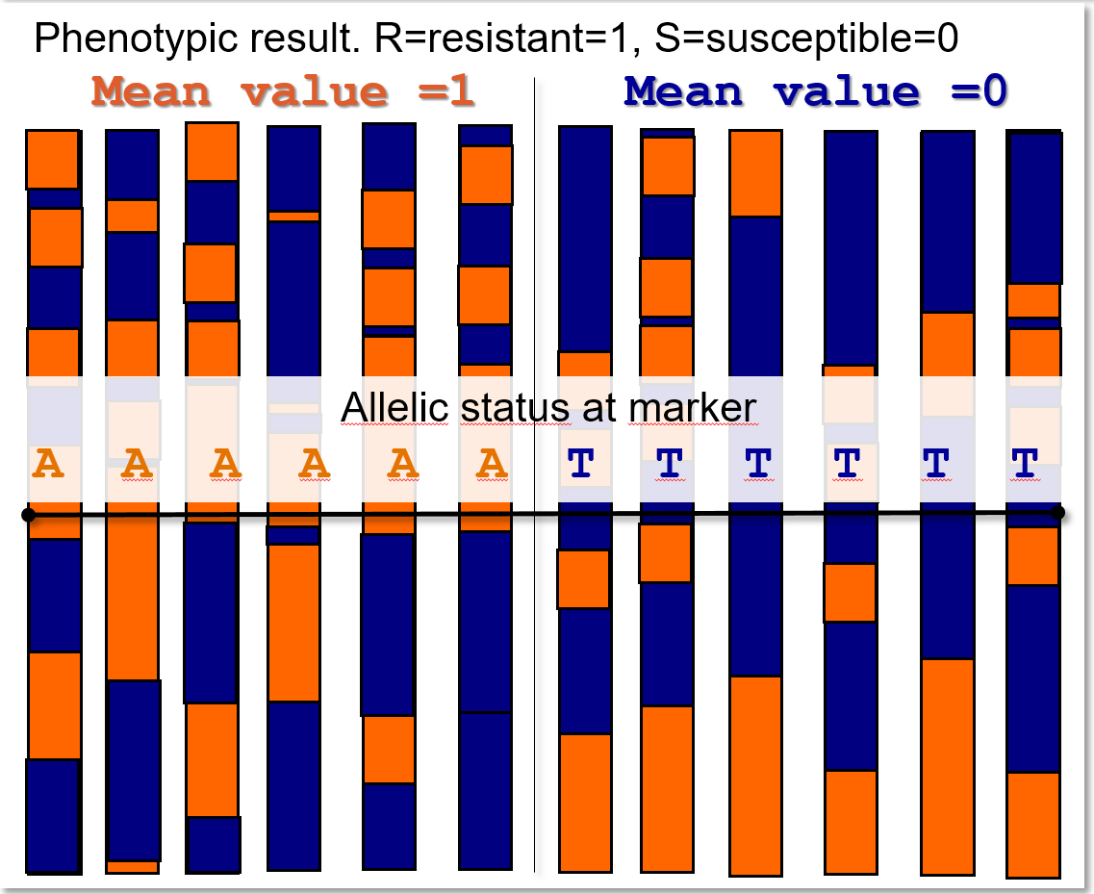
This panel of genotypes from which we take marker data and phenotypic data to study QTL: How was it developed?
 It could be the Mendelian F2 from a Mendelian F1, i.e. from crossing (a resistant and a susceptible) homo-
zygous parents. In that case one may disregard the 50% heterozygotes when comparing the mean trait value of
the two marker-homozygous groups. We expect allele frequencies of 50:50 at all segregating loci.
It could be a panel of inbred lines, developed from such Mendelian F1 (without selection), then-called RIL (recombinant inbred lines; again 50:50 allele frequencies).
With this, we are in what may be called bi-parental QTL-mapping.
11
It could be the result from selecting two phenotypically contrasting groups of lines (here: top-susceptible and top-resistant ones); with unknown allele frequencies and maybe even with >2 alleles. This would come under the term of Bulked Segregant Analyses.
It could be any collection of inbred lines, then again with unknown allele frequencies and with maybe more than 2 alleles/QTL. With such panel, we are in what is called GWAS (Genome-Wide Association Analyses) – especially if we employ genome-wide distributed markers.
The more densely distributed markers are, the higher is the pro-bability that we ‘stumble’ over markers which are in high LD with a QTL and indeed ‚mark‘ it . If we refrain from testing the signifi-cance of the QLT-effects and we employ very many markers, we approach the so-called Genomic Prediction (Genomic Selection).

Slide 12
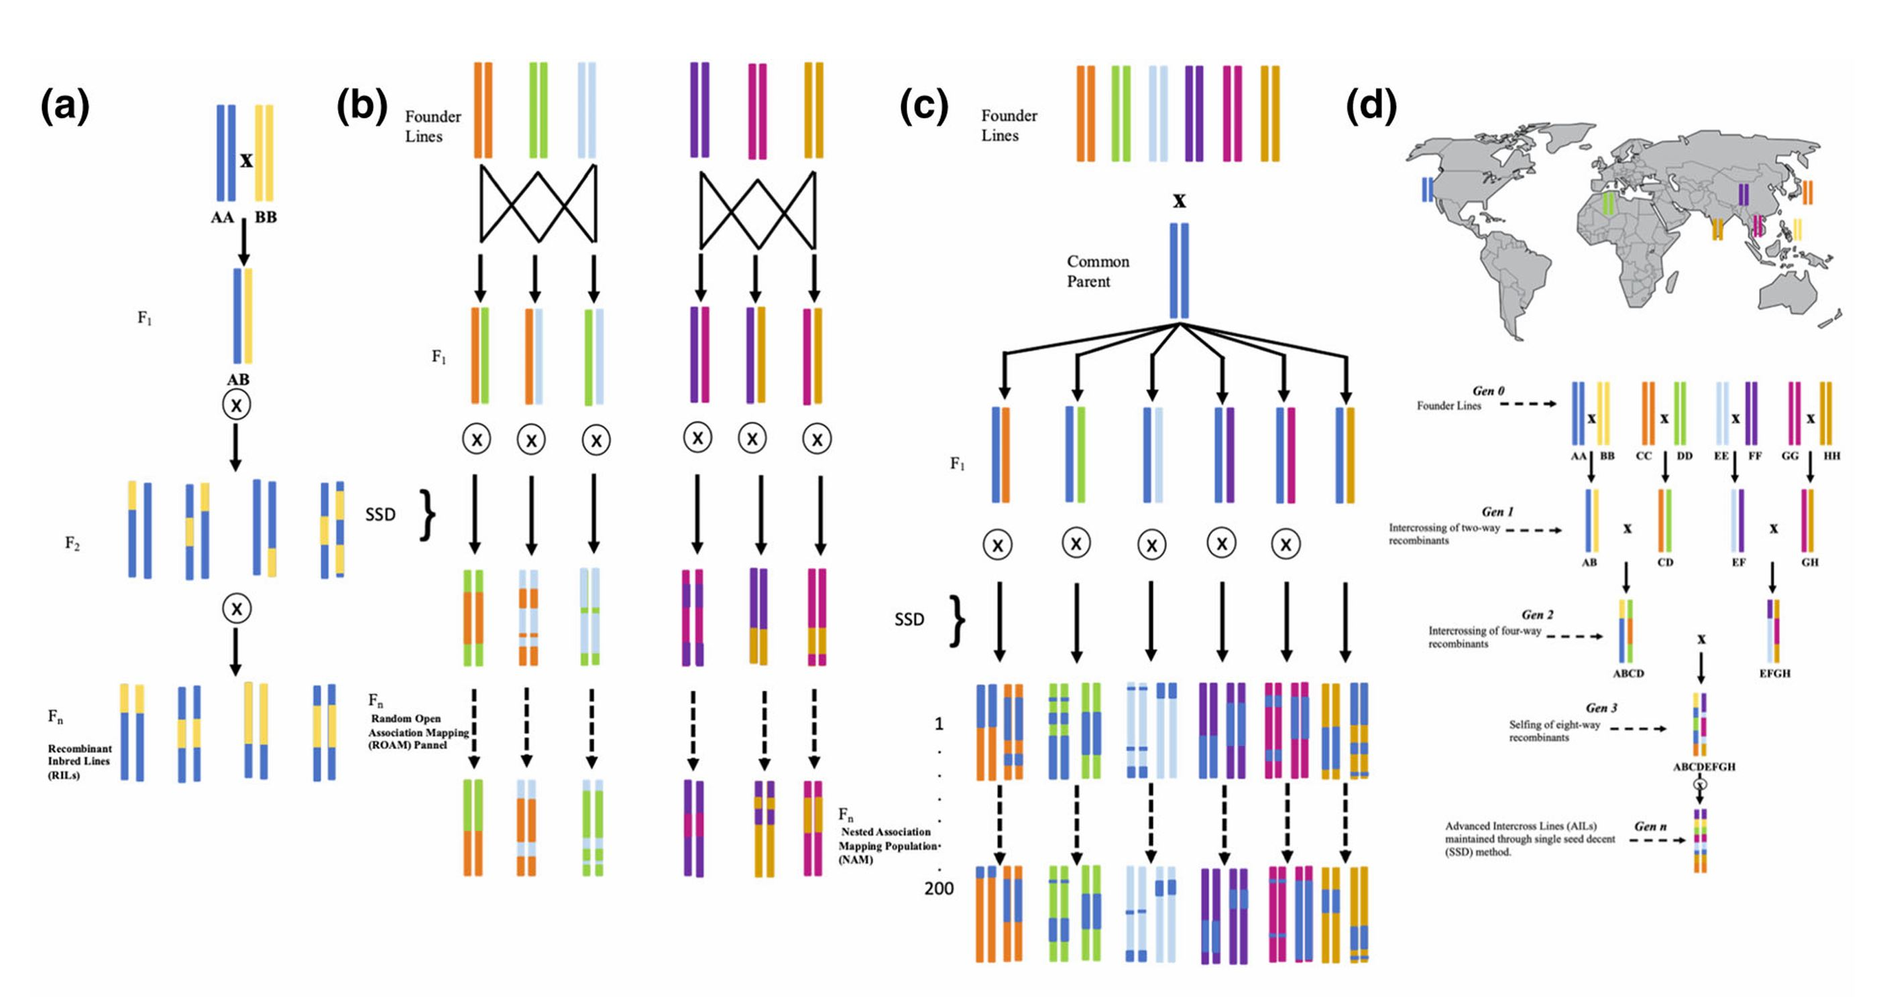
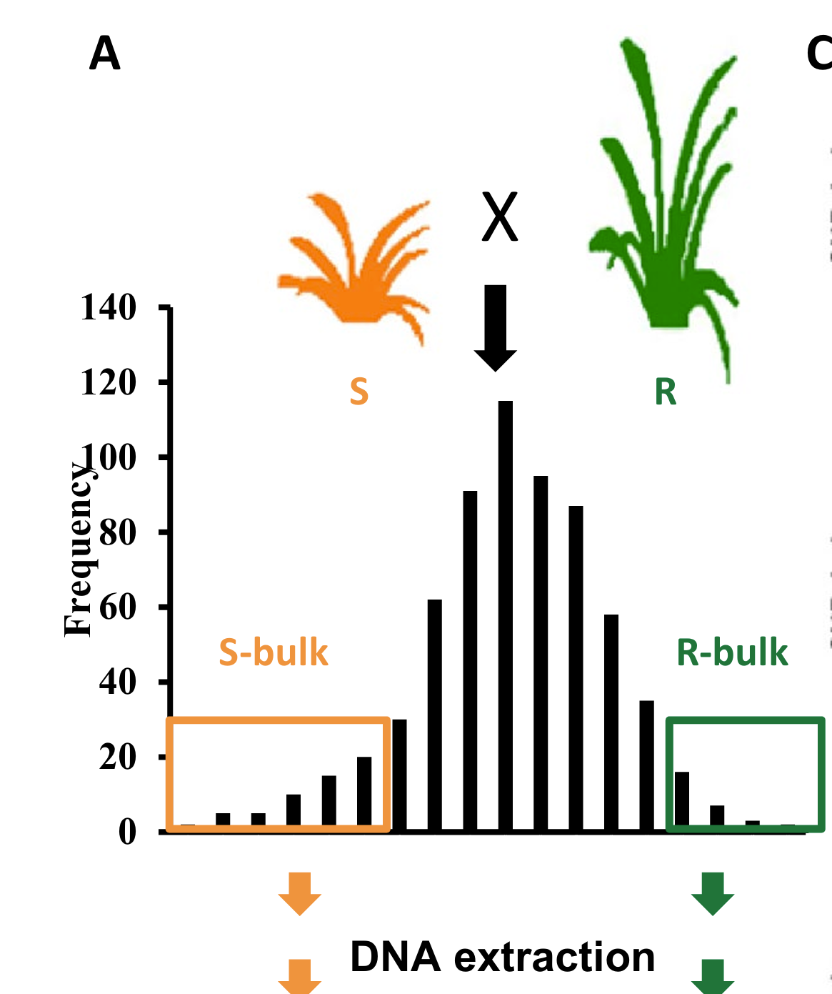
Some famous strategies to develop material which is useful to map (locate) QTL and to estimate QTL effects on traits. I only give a hint here.
(a) Bi-parental population. (b) Random Open Association Mapping panel.
(c) Nested Association Mapping population (NAM). (d) Multi-Parent Advanced Generation Intercross population (MAGIC).
Start of Bulked Segregant Analy-sis. Choose extreme bulks …
DOI: 10.1007/s12539-019-00344-9
https://doi.org/10.1007/s10681-021-02925-6
Founder lines
Founder lines
Common
parent
F₁
F₁
Founder lines
F₁
F₂
SSD
SSD
F_{n}
_{RILs}
F_{n}
NAM
12

Slide 13
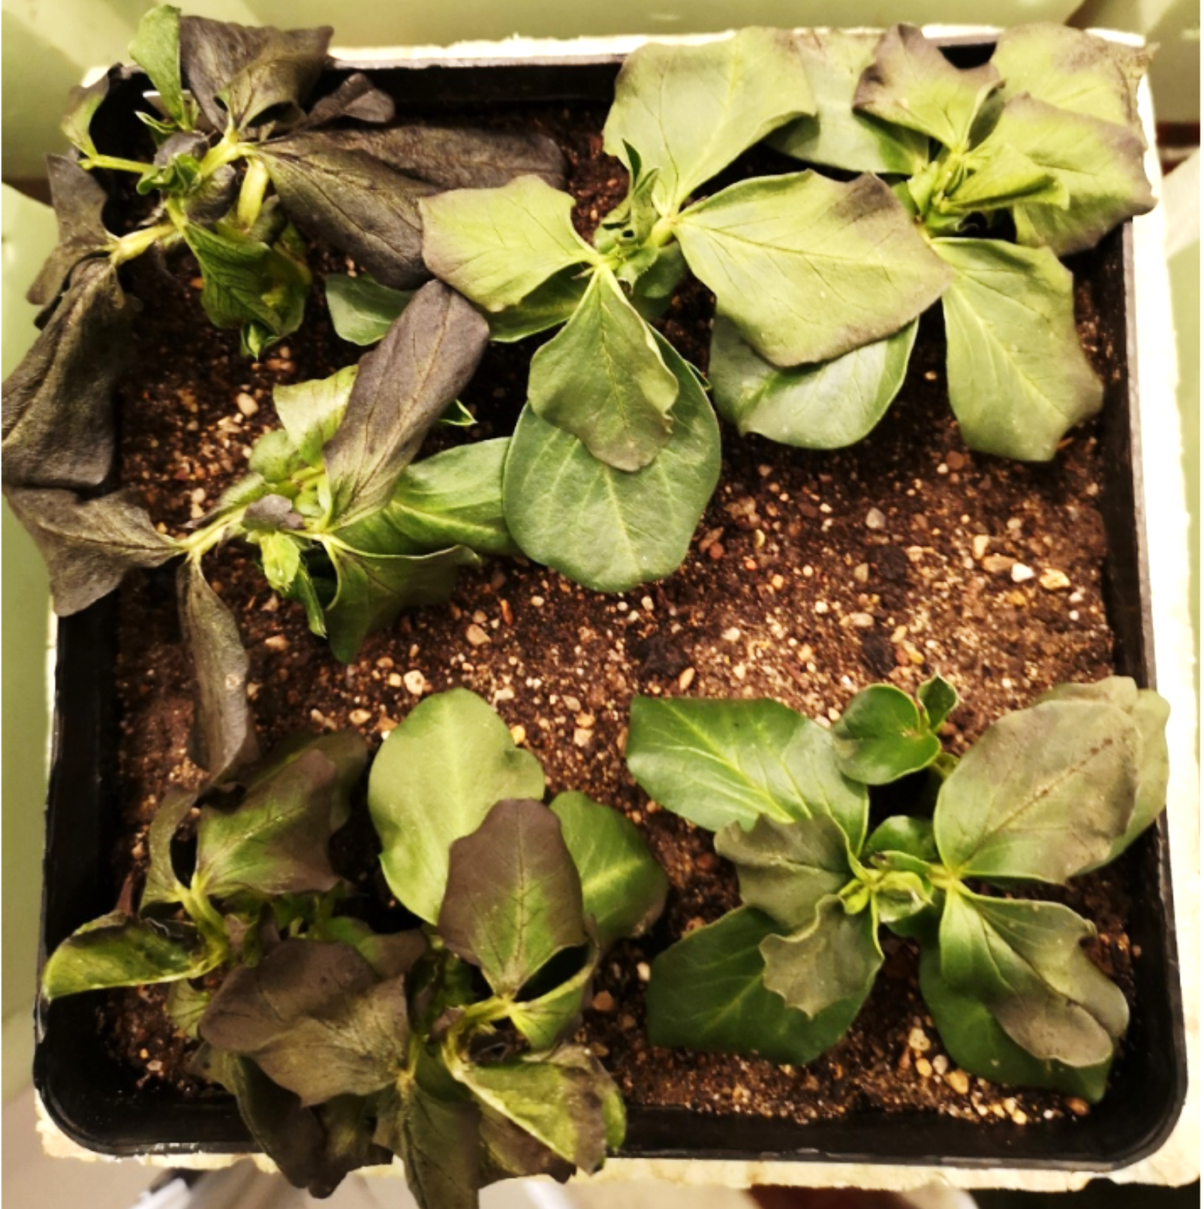
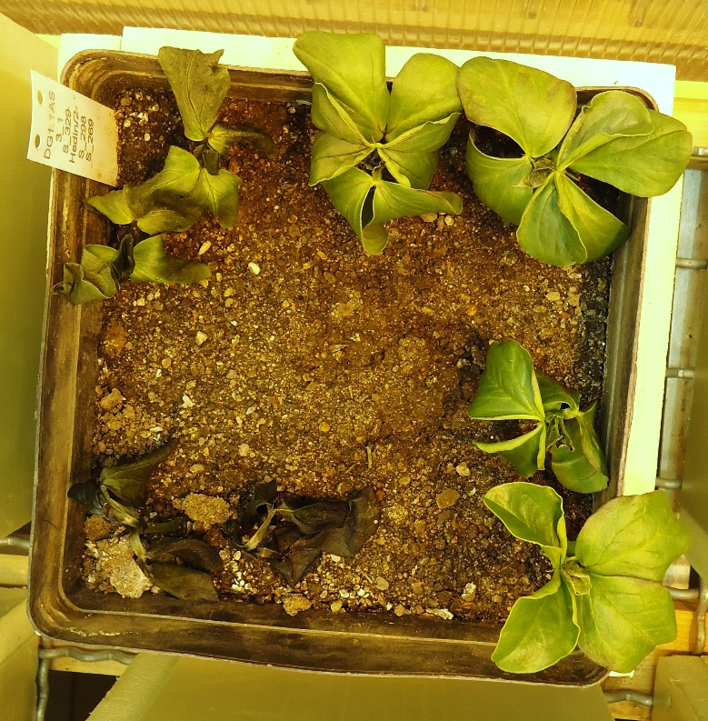
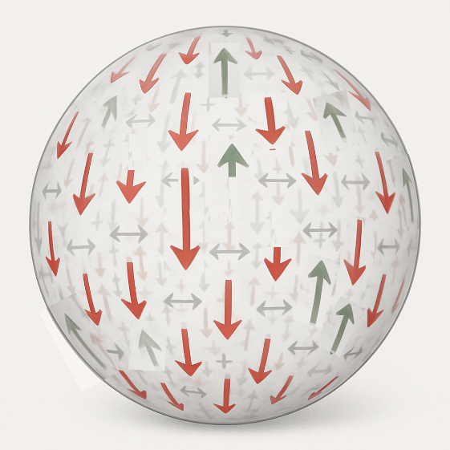
Freezing susceptible and freezing tolerant faba bean geno-types showing correspondingly harsh and minimum symptoms after an artificial freezing test (e.g. Arbaoui et al., 2008. Field Crops Research 106, 60-67)
Tolerant
Susc.
For simplification we argue as if the SNP alleles were the causative polymorphisms of the genes, we neglect LD decay and bias in effect estimation & such issues. Basi-cally, we think of Marker Score or Genetic Value as Σ(effects of positive & negative alleles). We may neglect dominance and epistasis. This may make us think linearly. Indeed, DNA is a linear double chain.
Yet, the effect of the genes on phenotype is of course the result of many and complex effects and interactions. Maybe we better visualize this as 3D sphere?.
Ponder joint result of favourable and unfavourable alleles on phenotype.
1 -1 1 -2 3 -1 -3 4
© W. Link
Reddish: ‚bad‘ alleles
Greenish:‚ good‘ alleles
Grey: neutral alleles
Sum up good and bad effects and get the Marker Score of a genotype. Here: Σ=+2
Tolerant
Susc.
Red arrows (large or small negative effects) are more frequent than the greenish arrows. Cross & recombine and (marker-assisted) select towards green arrows ► create improved genotype ☺
13

Slide 14
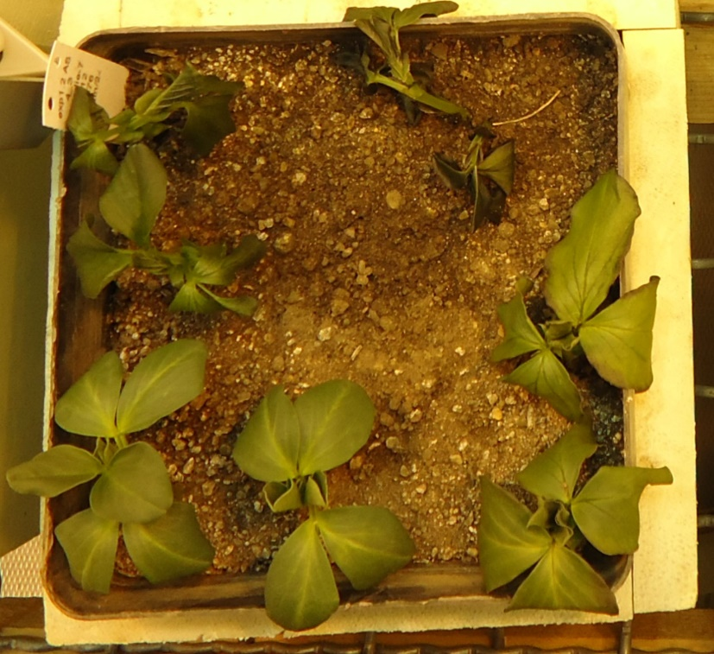
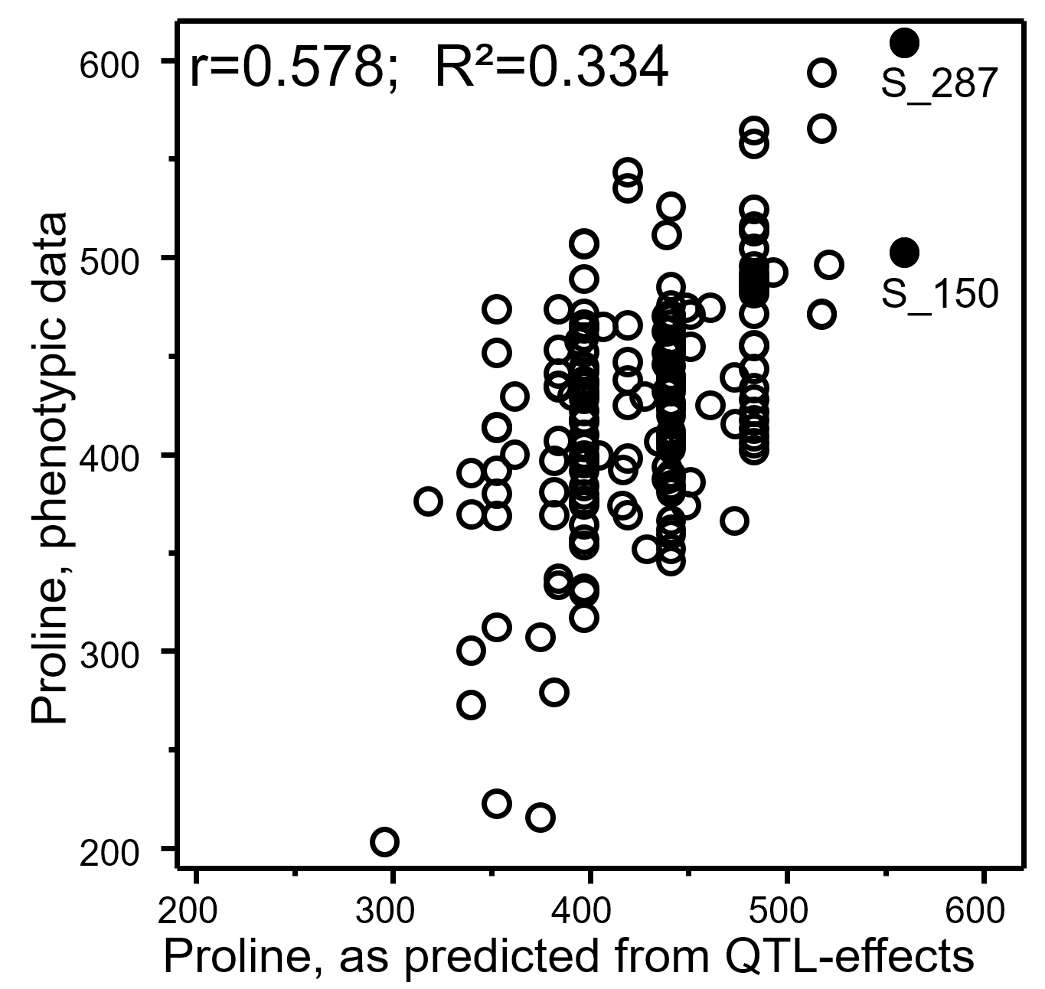
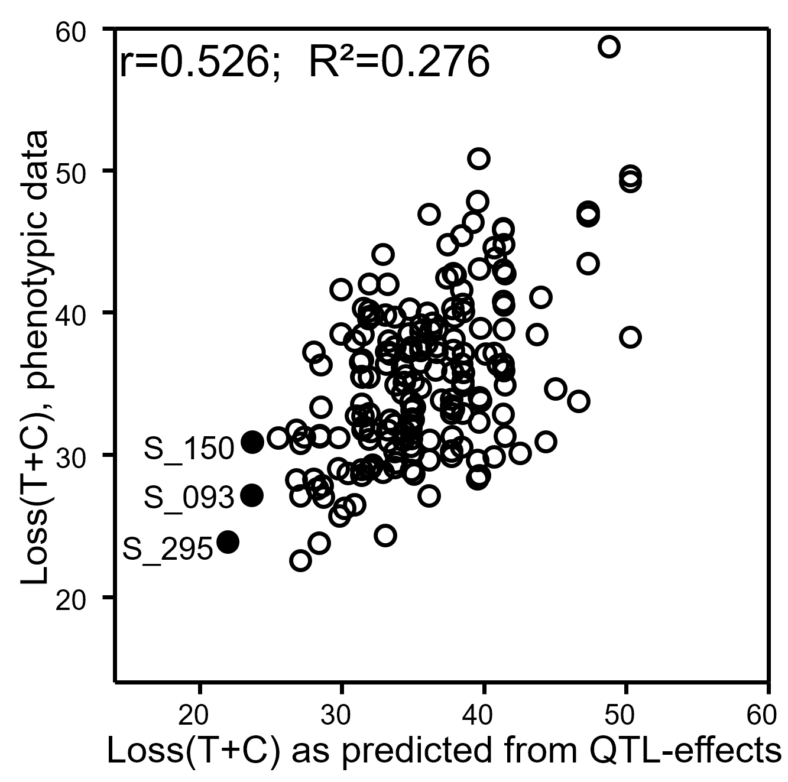

Proline content as physiological aspect of drought tolerance. Five markers marked significant effects. Marker Scores explained 33.4% of the phenotypic variation. Loss of Turgor and Colour (T+C) as freezing injury symptom. Eight markers were significant. Marker Scores explained 27.6% of the phenotypic variation of this trait (Ali et al., 2016).
Differences in resistance
© Windhorst
Marker Scores
14

Slide 15
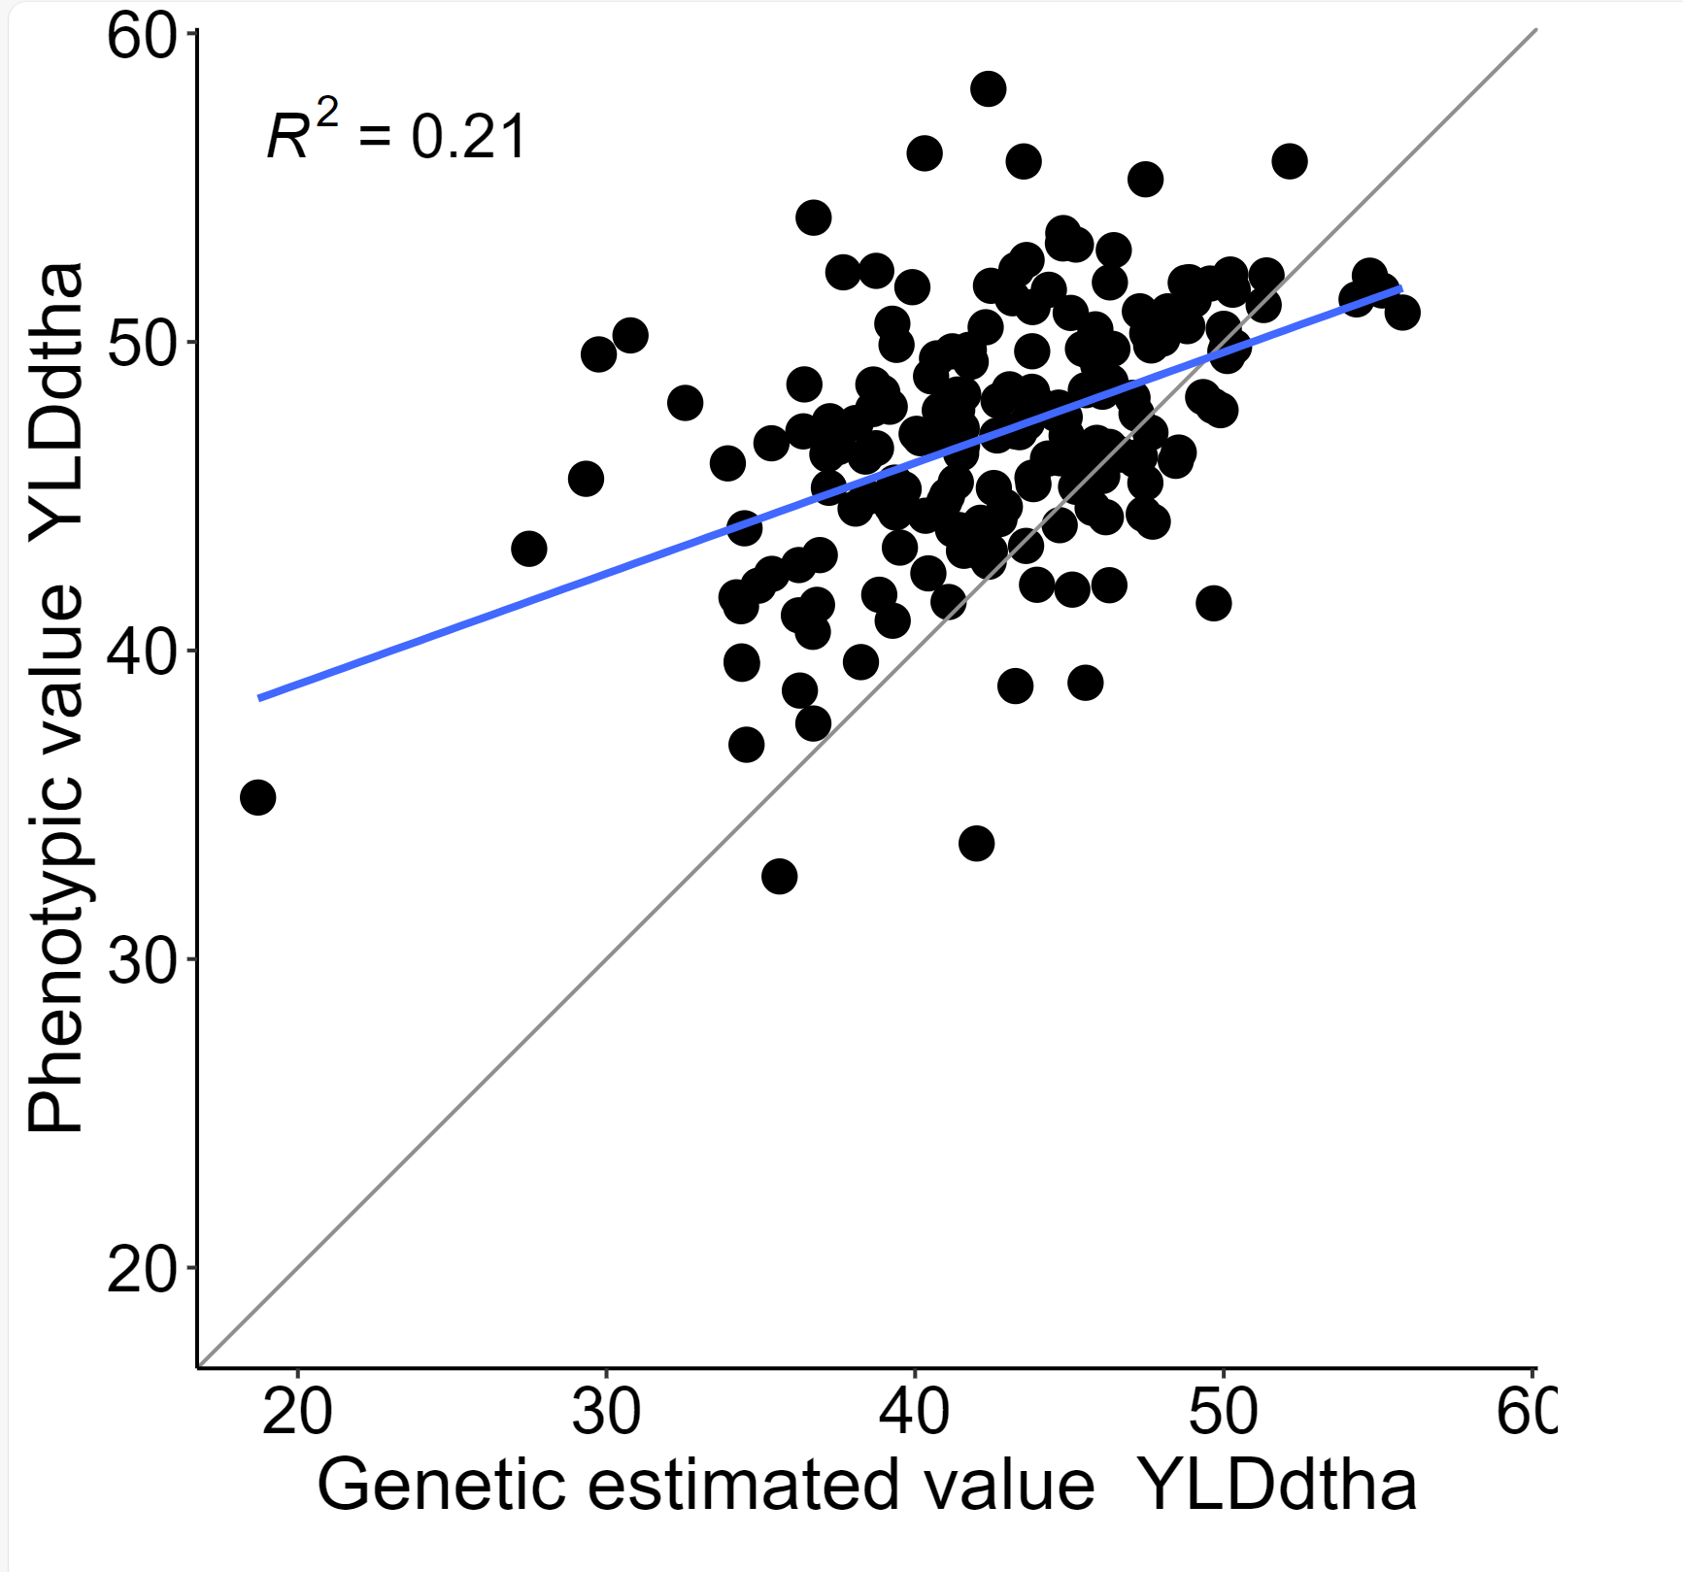
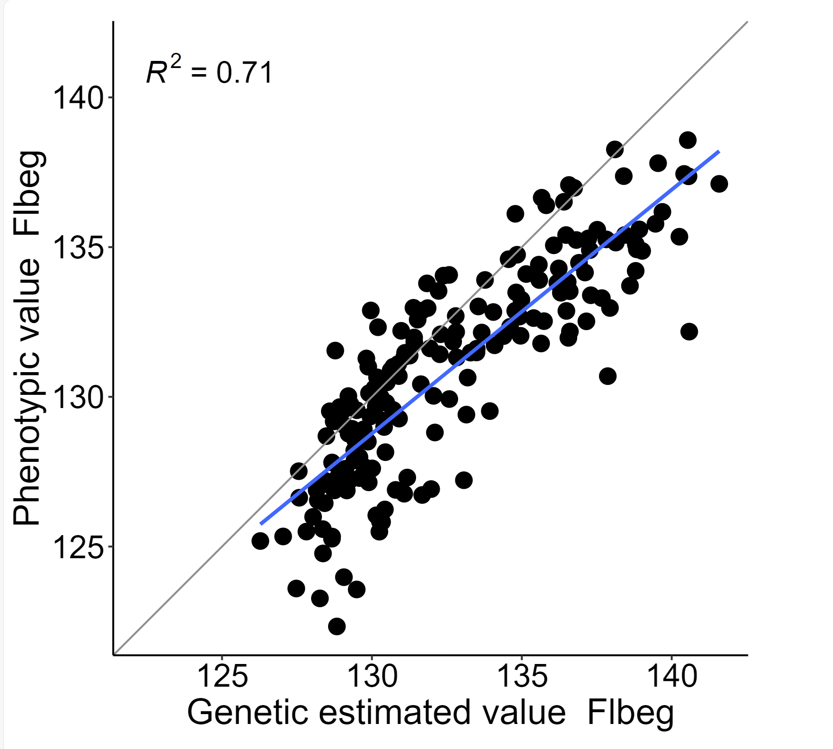

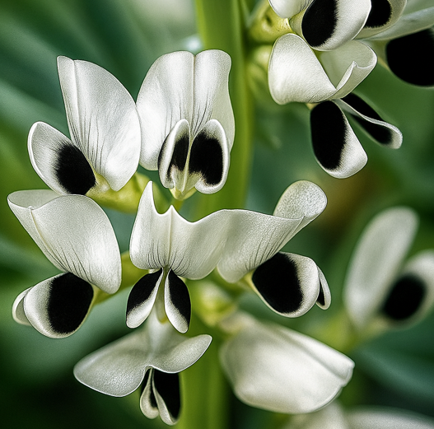
Genomic Estimated Genetic Values (GEGV) in Genomic Prediction employing 17205 SNPs instead of Marker Score from few to several (significant) marker effects. Faba bean (Windhorst and Link 2024). X-axis: GEGV (instead of Marker Scores). Field data from 11 environments; Y-axis: Validation via data from 7 further environments.
This approach can well predict the performance of the same genotypes in other environments.
Windhorst and Link 2024, Poster 21, GPZ Geisenheim
Y-axis
Y-axis
See at ...
UNPLAB-BrMeth_Ch-11 page 33
Begin of flowering, offspring
Grain yield, offspring
15
Genomic prediction for begin of flowering (days)
Genomic prediction for grain yield (dt/ha)

Slide 16
From here you may go to UNPLAB-BrMeth_Ch-1[Intro]
16
16

